Slide 1

Digital Clock on FPGA board nexys a7 by Jorel Caoile, Gita Temelkova, len quach

Slide 2
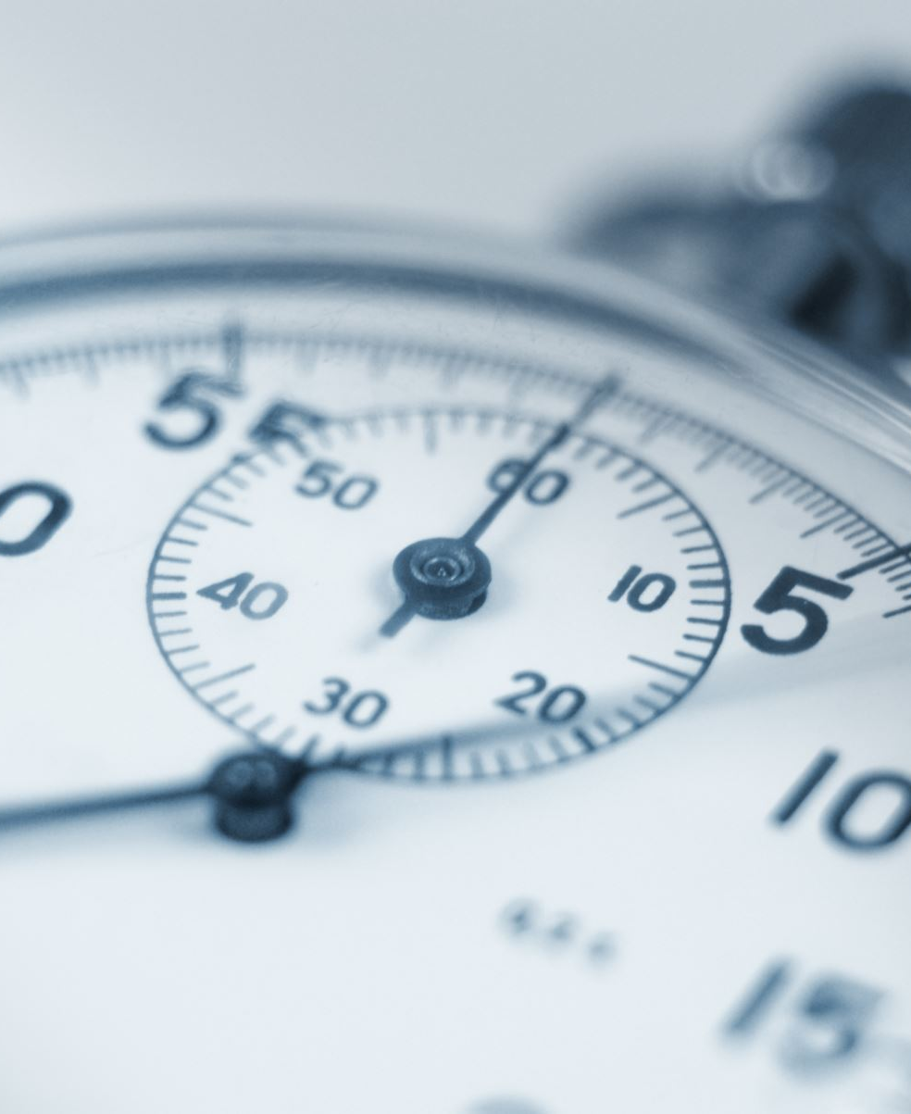
DIGITAL CLOCK FEATURES
Military to standard time
Loading and setting time
Flash on every full hour
Stopwatch
Timer

Slide 3
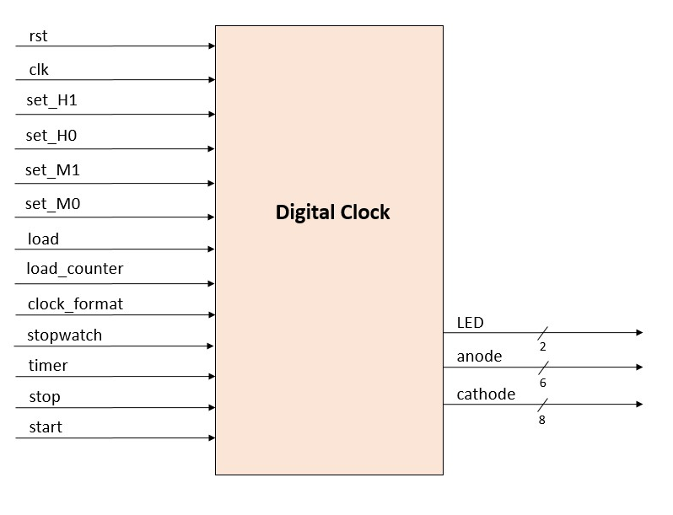
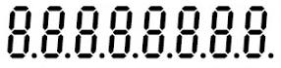
Top diagram anode output : [0] least significant second [1] most significant second [2] least significant minute [3] most significant minute [4] least significant hour [5] most significant HOUR

Slide 4
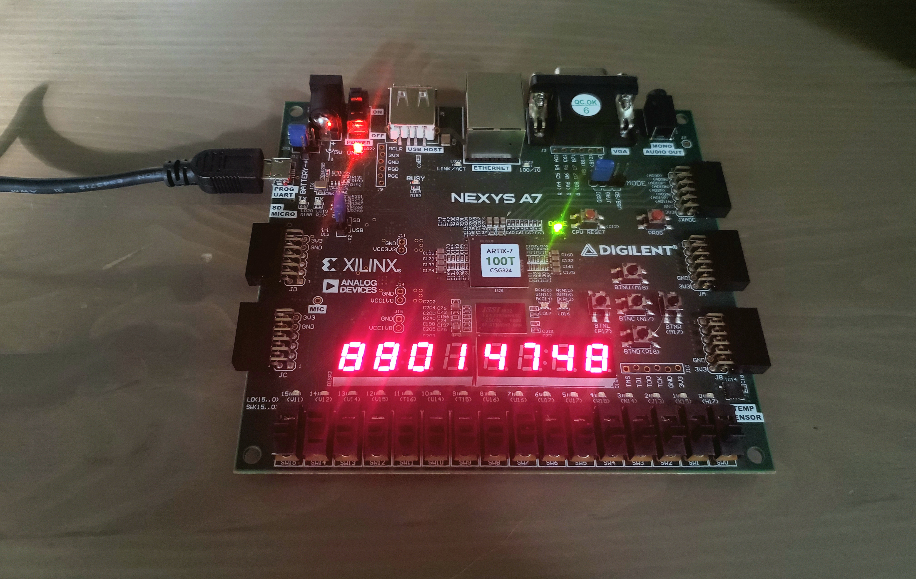
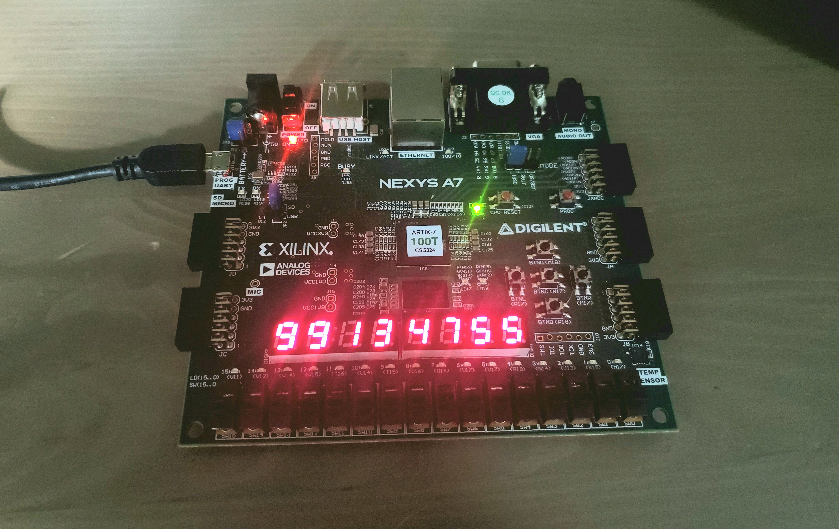
Military to standard time
Standard American Time
Military Time
using switch 14

Slide 5
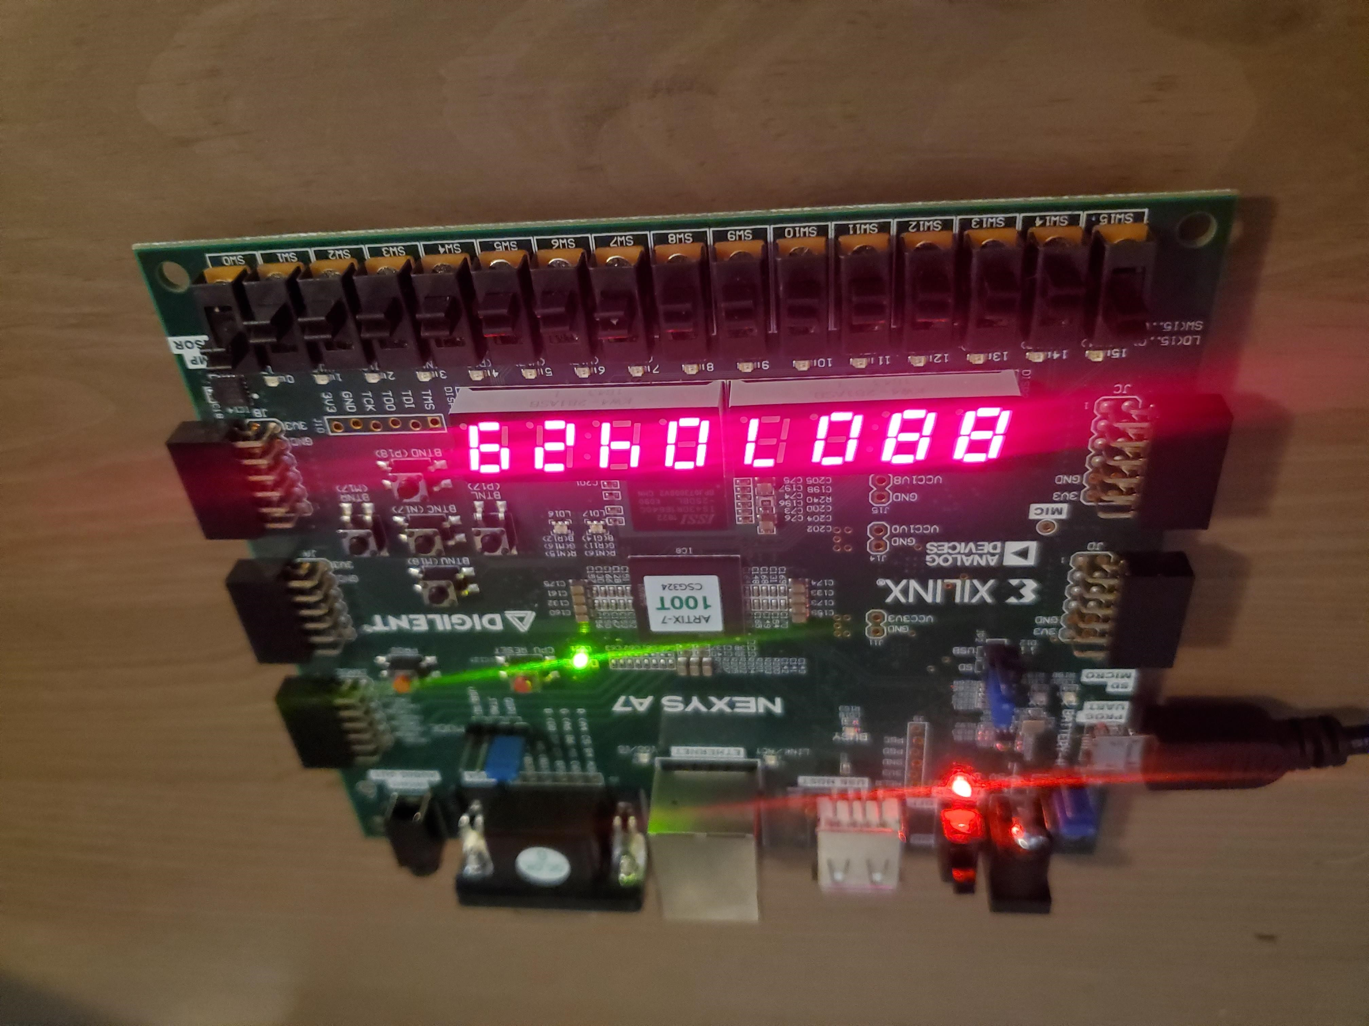
Loading and setting time SET time while switch 15 is high when done switch 15 goes low

Slide 6
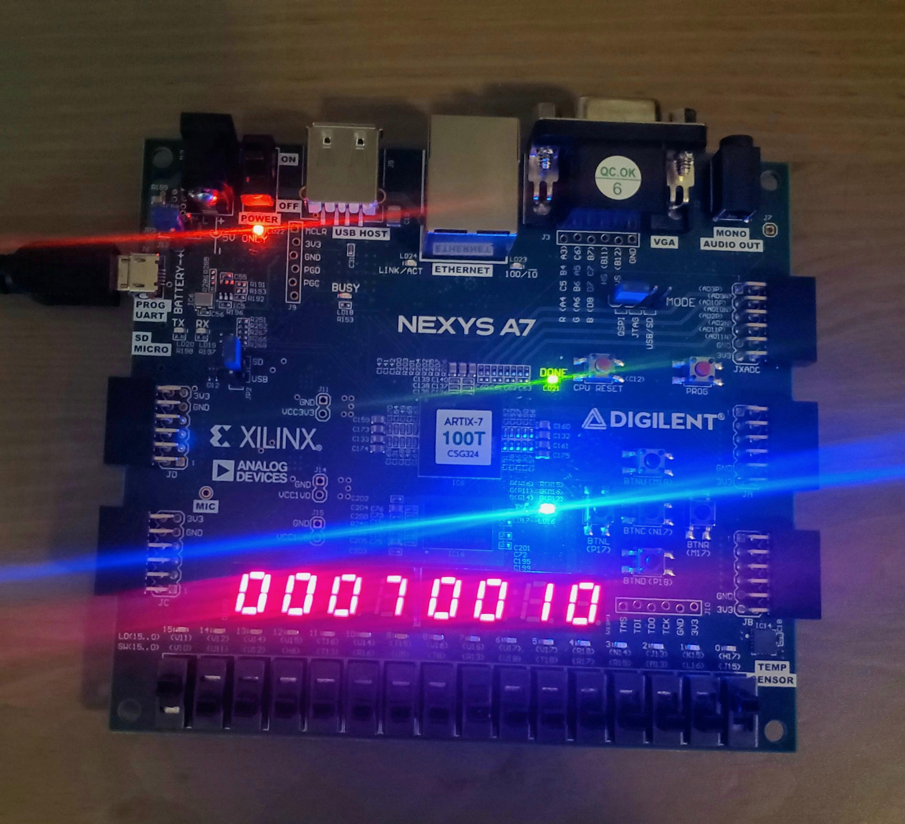
FlasHing blue rgb led on every full hour (10 seconds past 7:00 )

Slide 7
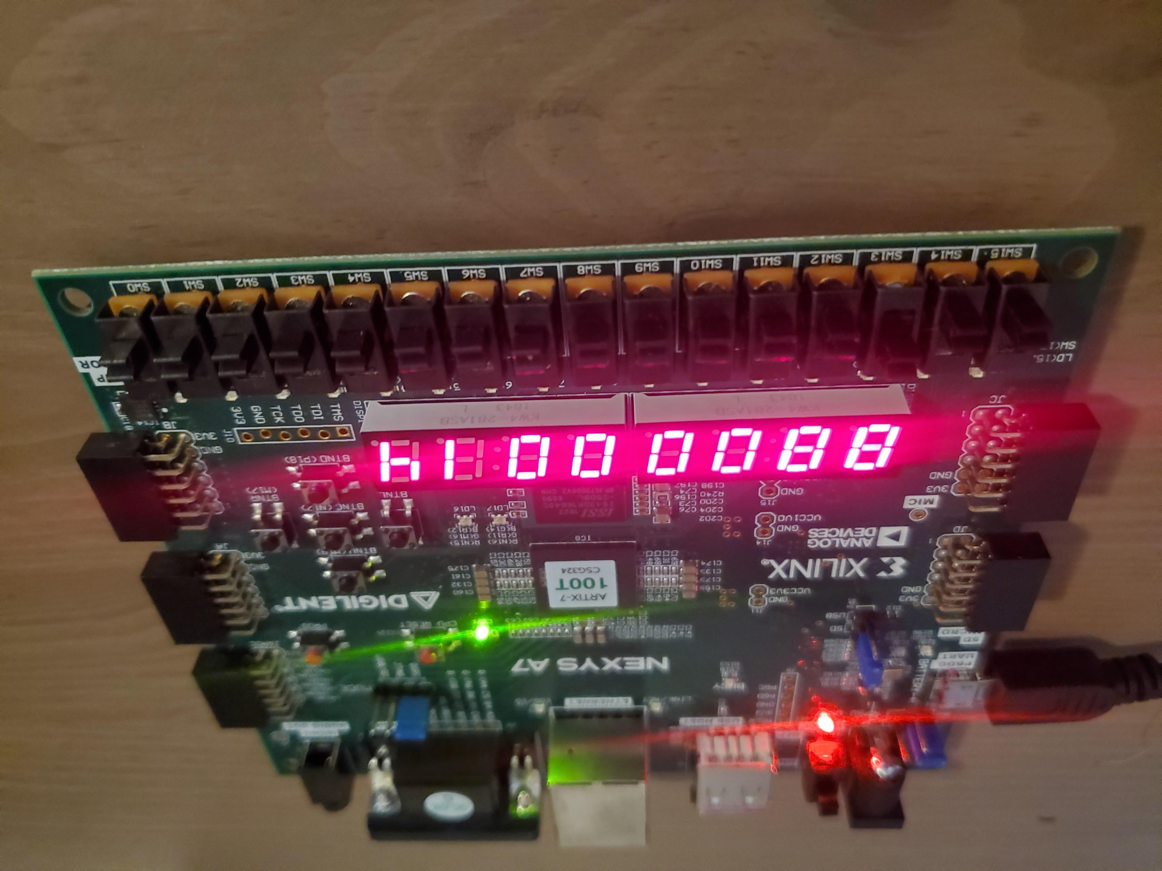
Stopwatch using switch 13 MAx value 23:59:59 (counting 14 seconds)

Slide 8
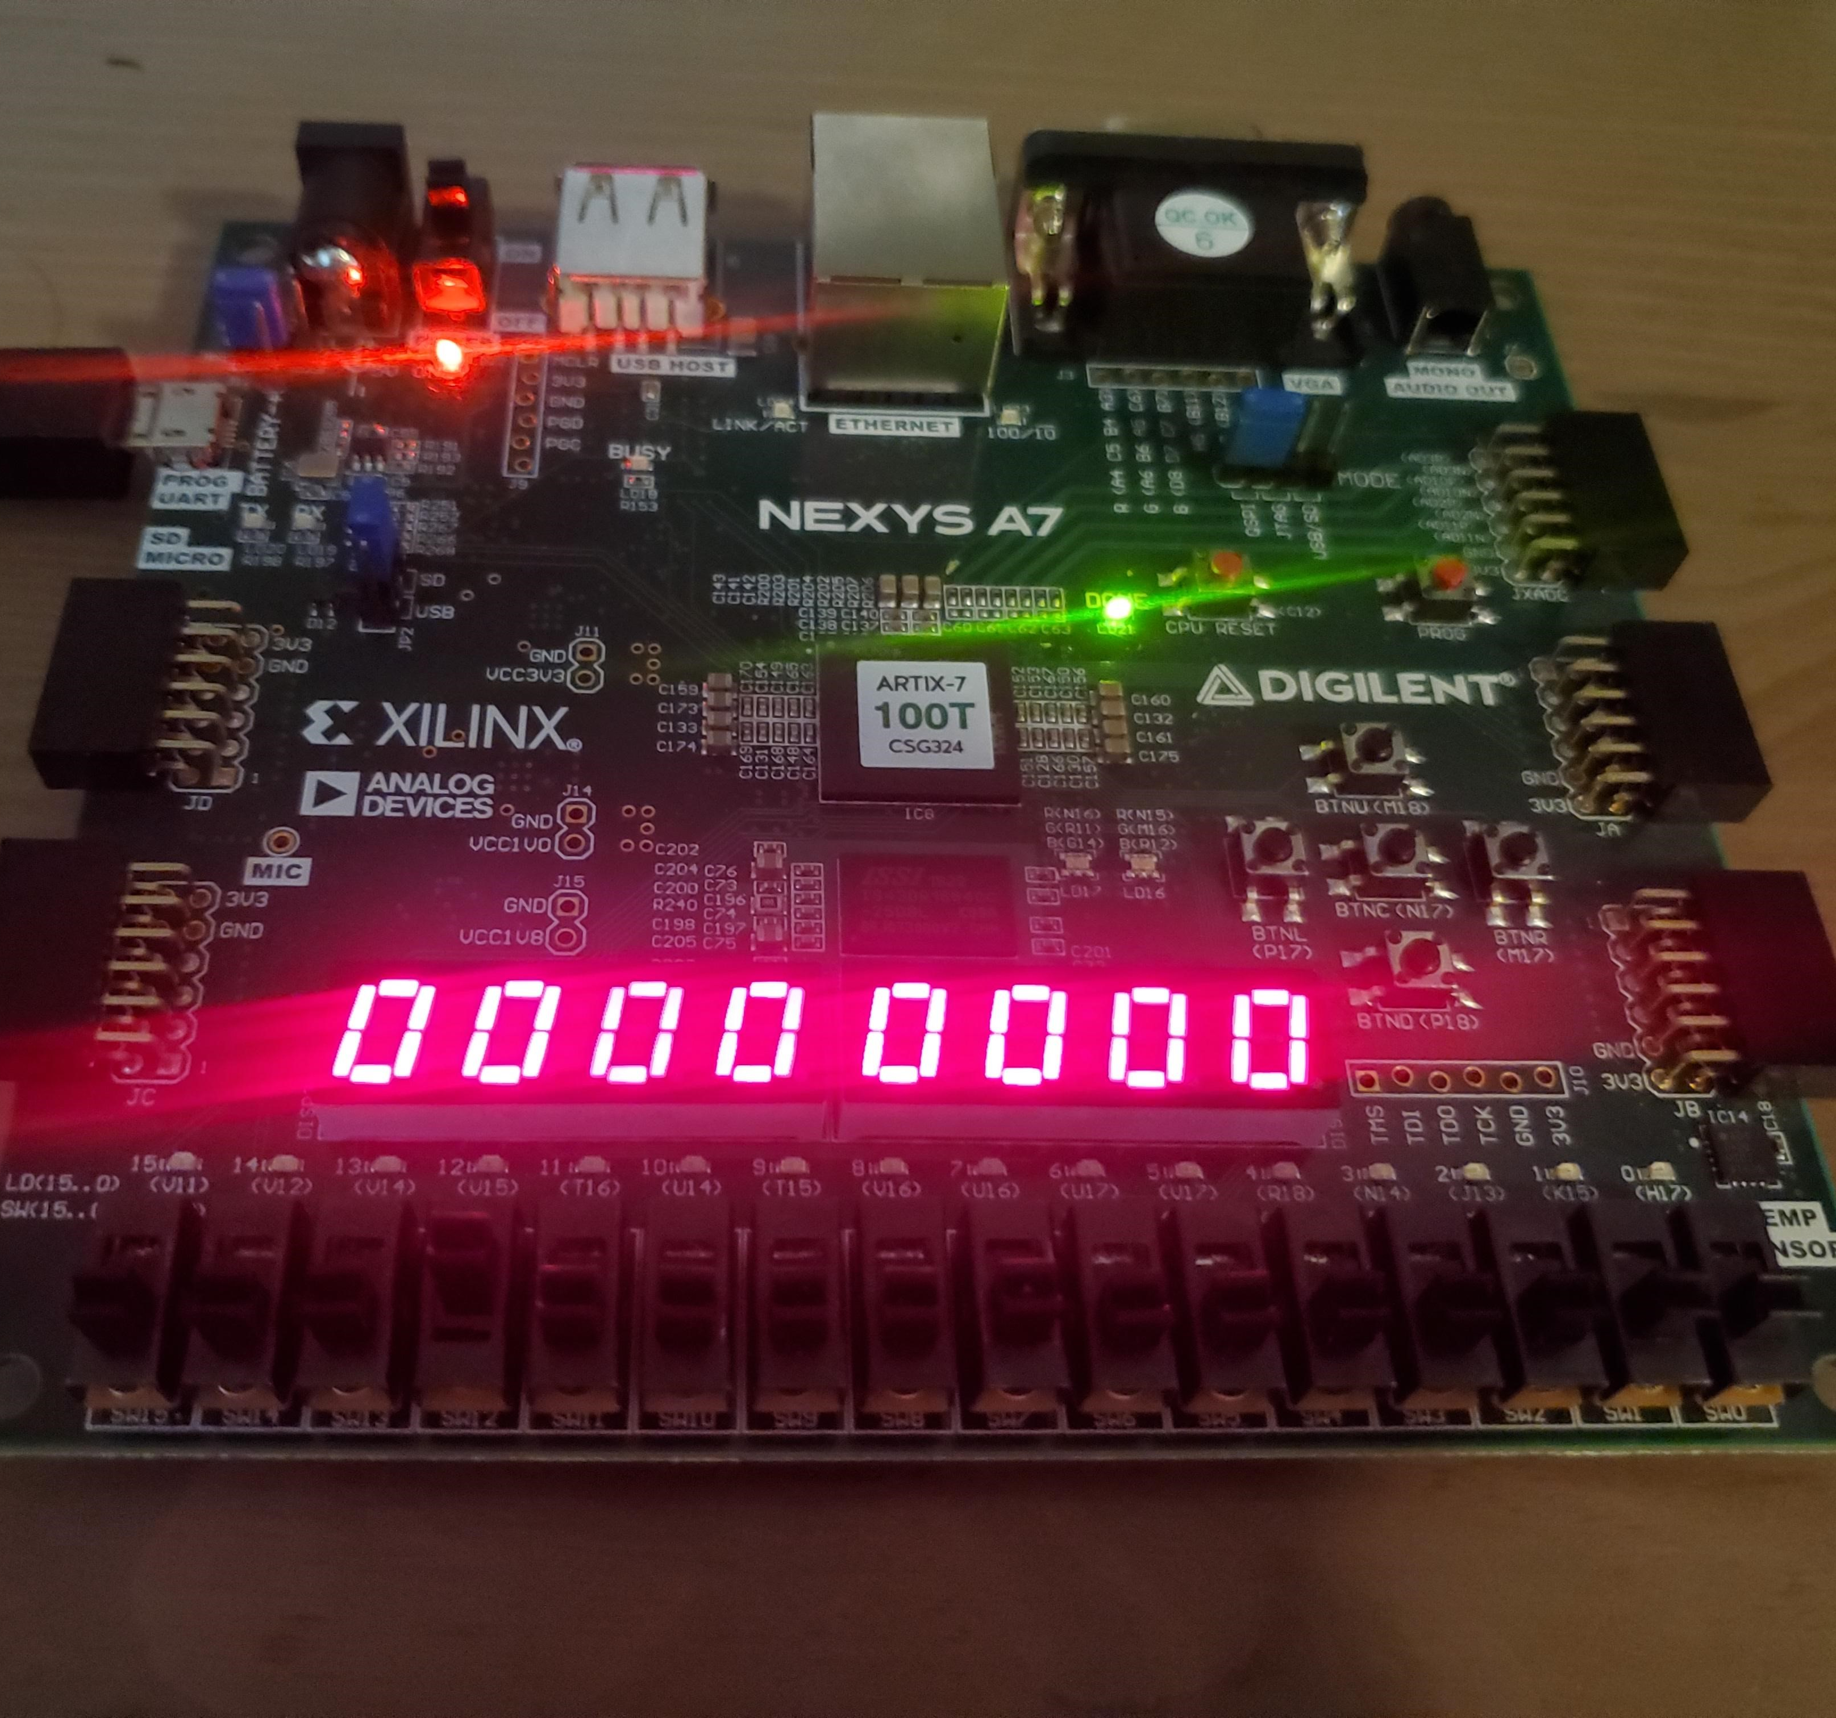
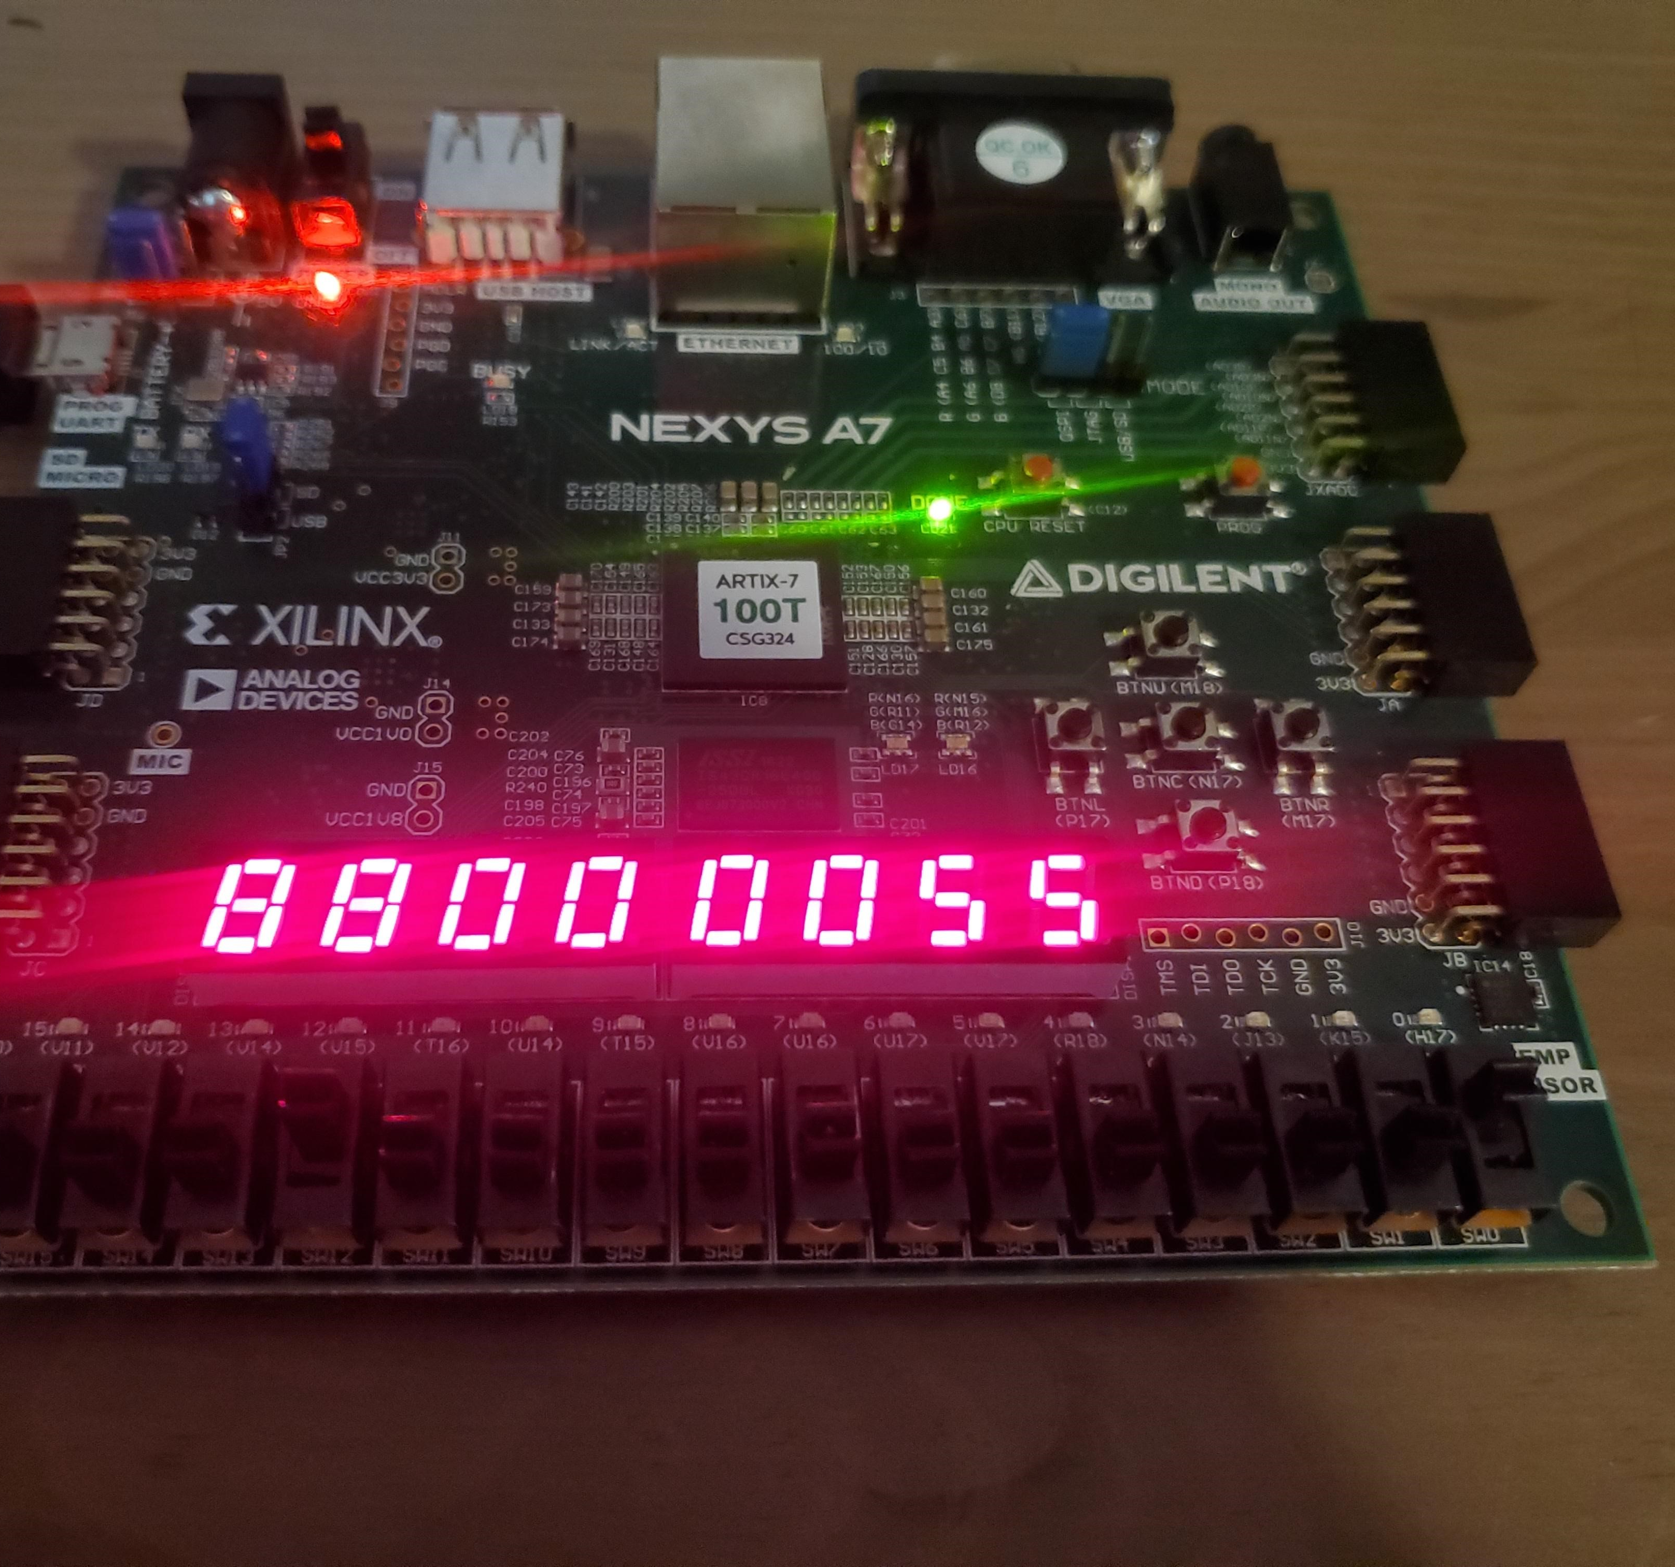
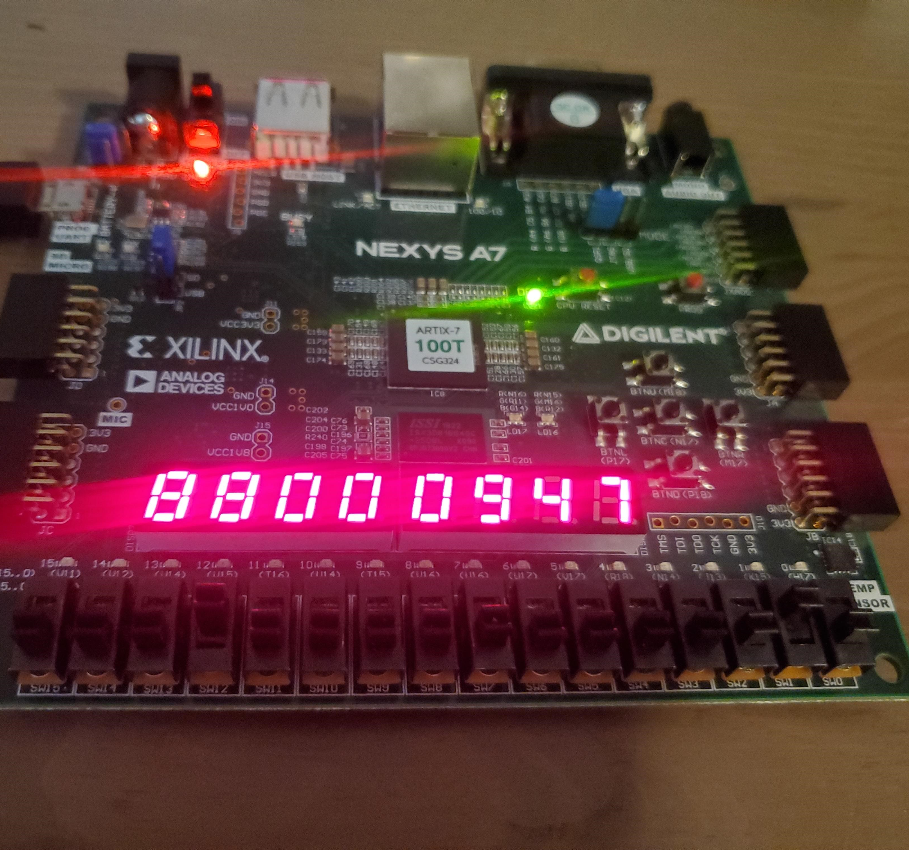
Timer using sw12 to activate the feature switch 1 high and pressing left button can set 1 - 9 least significant minute switch 2 high AND PRESSING LEFT BUTTON CAN SET 1 - 5 most significant MINUTE SWITCH 3 HIGH AND PRESSING LEFT BUTTON CAN SET 1 - 9 LEAST SIGNIFICANT hour SWITCH 4 HIGH AND PRESSING LEFT BUTTON CAN SET 1 - 5 MOST SIGNIFICANT hour button up is reset button down starts the timer Max value of timer is 23:59:00

Slide 9
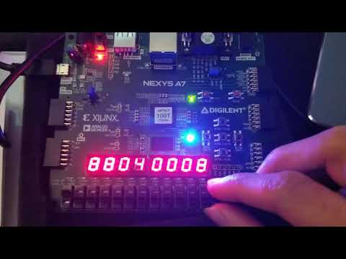
Video demonstration

